Slide 1

Analyzing the Port Wine
Bee Kim

Slide 2
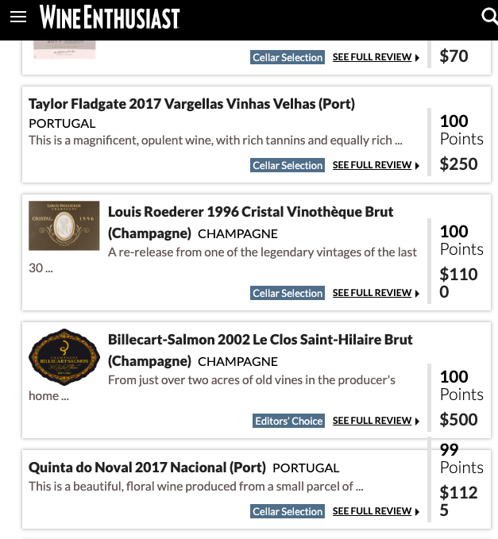
Website/Data
Wine Enthusiast Magazine
Data Obtained
Wine Name
Wine Price
Wine Category
Wine Variety
Wine Origin
Country
Region
Points Given by WE Magazine
Description given to each wine by WE Magazine

Slide 3
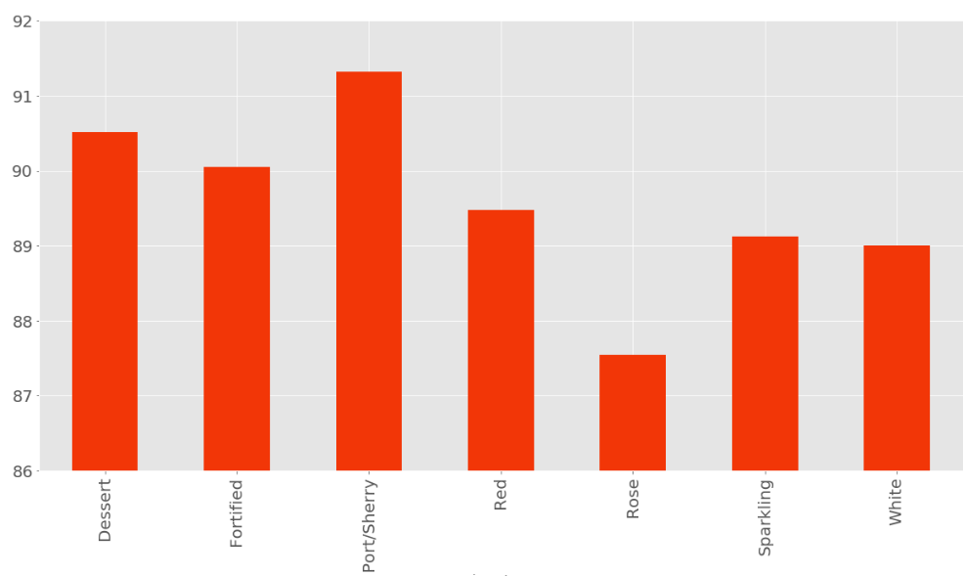
Original Wine Data
Wine Points
By Category

Slide 4
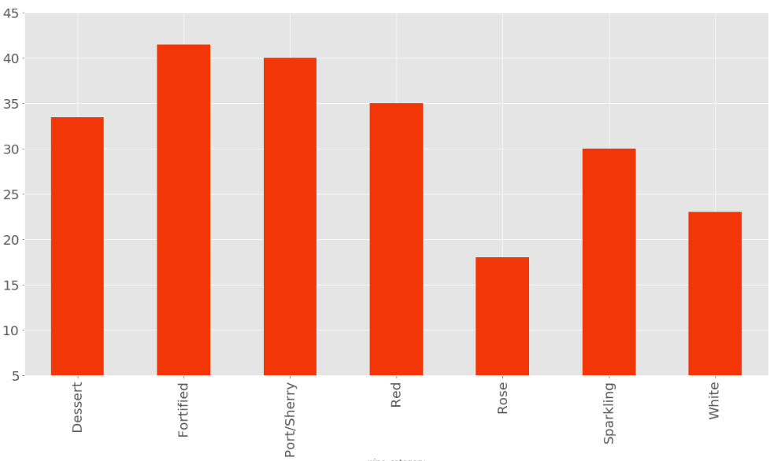
Original Wine Data
Wine Price
By Category

Slide 5
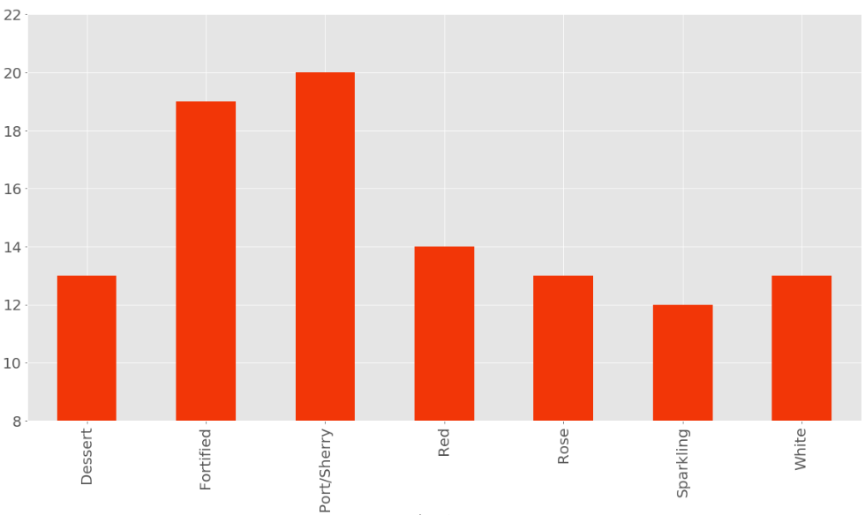
Original Wine Data
Alcohol Content (%)
By Category

Slide 6
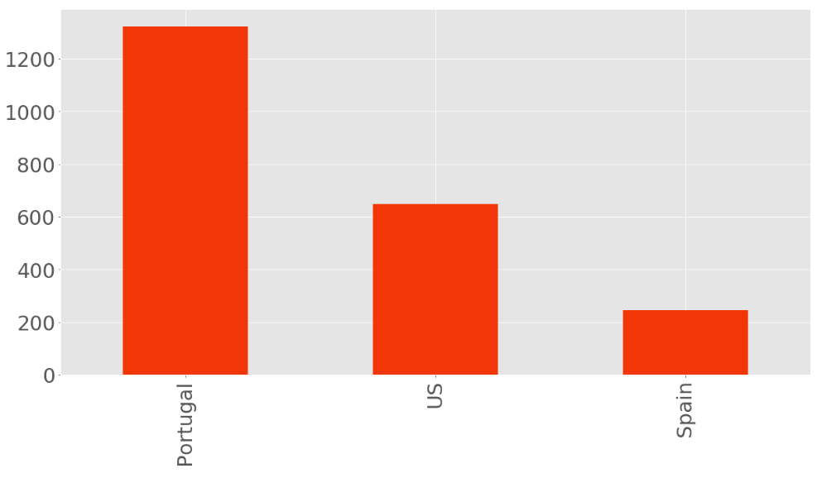
Port Wine Dataset - Country
2216 Port Wines
Portugal : 1322
US : 648
Spain : 246

Slide 7
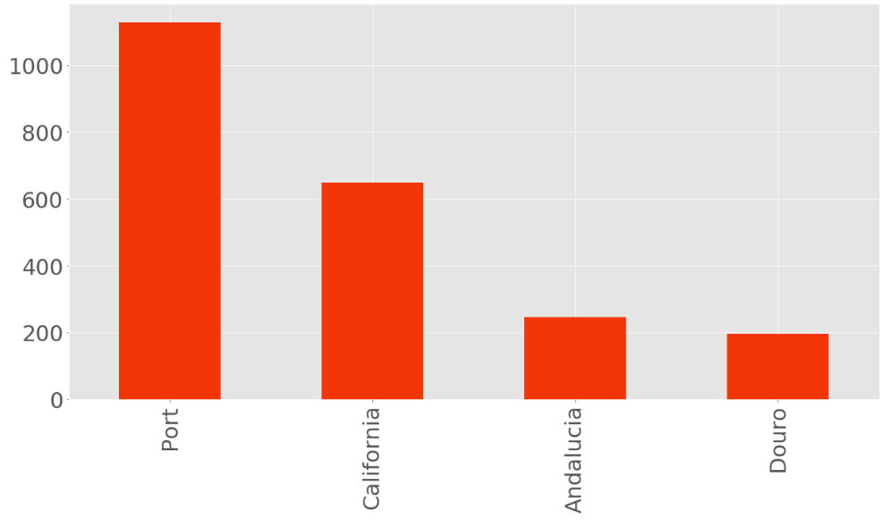
Port Wine Dataset - Region
Portugal
Port
Douro
US
California
Spain
Andalucia

Slide 8
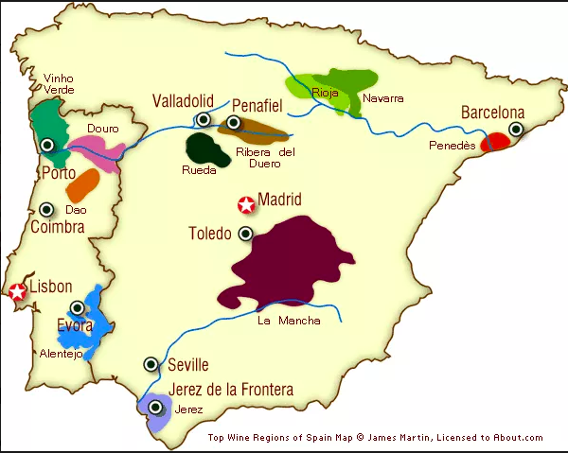

Slide 9
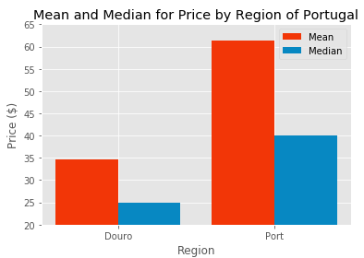
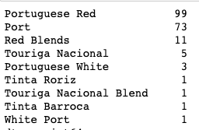

Douro & Port
Douro
Port

Slide 10
Name “Port”
Under European Union Protected Designation of Origin guidelines, only the product from Portugal may be labelled as port or Porto.
In the United States, wines labelled "port" may come from anywhere in the world, while the names "Oporto", "Porto", and "Vinho do Porto" have been recognized as foreign, non-generic names for port wines originating in Portugal.

Slide 11

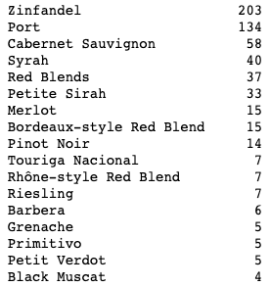
Spain US

Slide 12
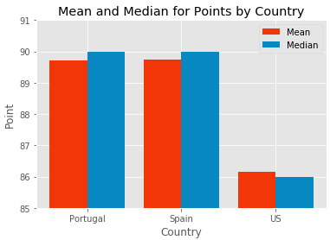
WE Mag Points for Port wines By Country

Slide 13
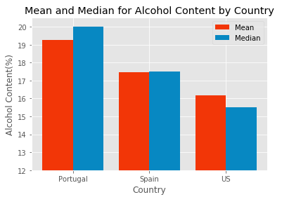
Alcohol Content
Of
Port wine
By Country

Slide 14
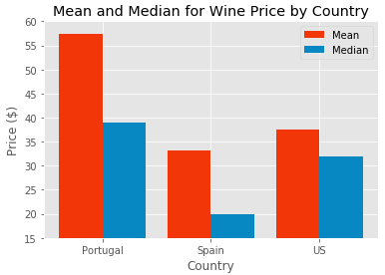
Wine Price of
Port Wine By Country

Slide 15
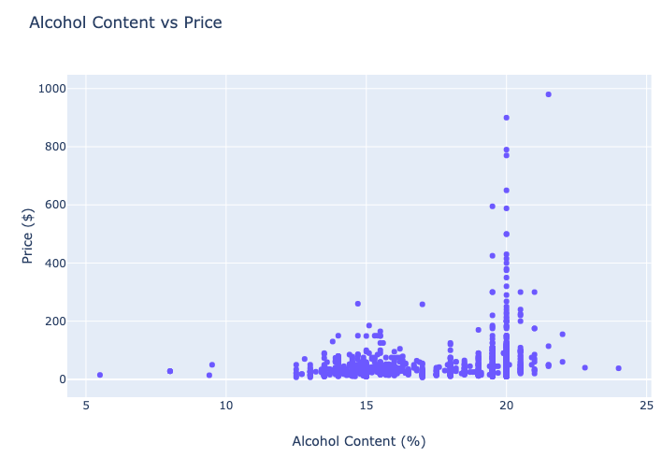

Slide 16
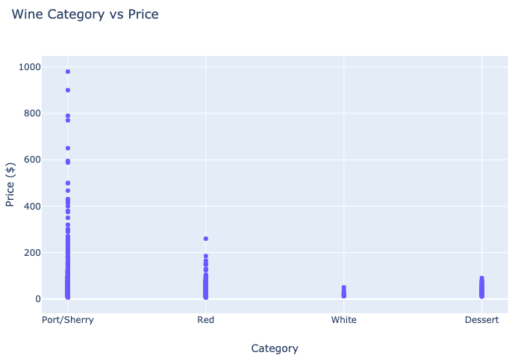

Slide 17
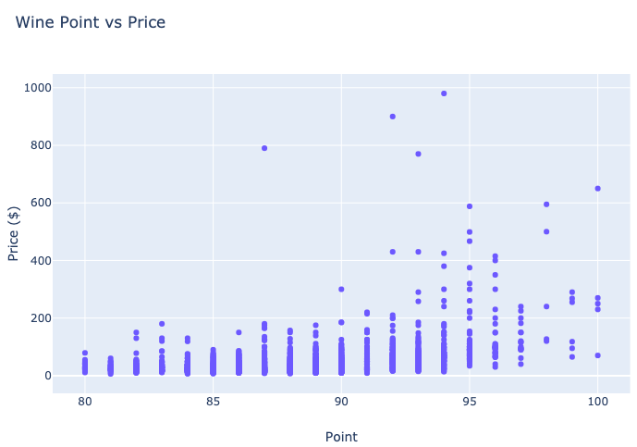

Slide 18
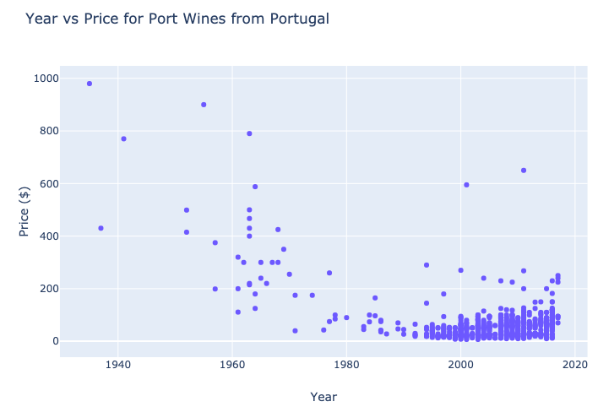

Slide 19
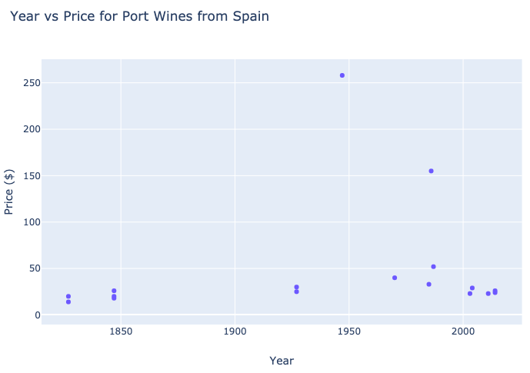

Slide 20
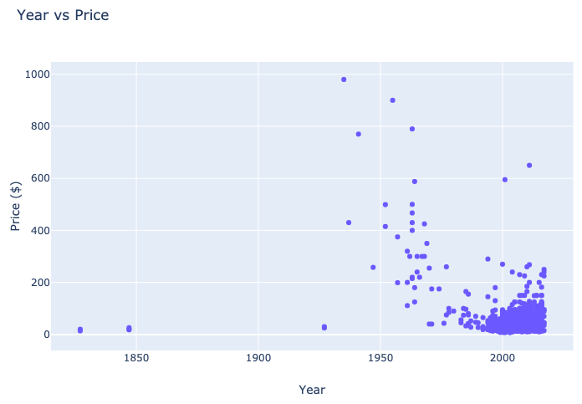

Slide 21
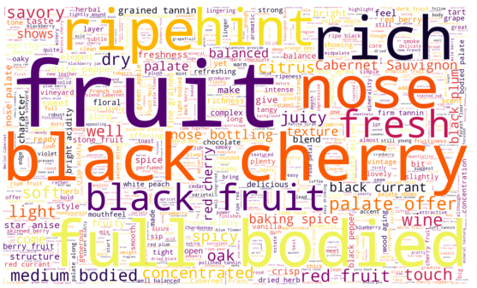
All wines on WE Mag

Slide 22

Port Wines on WE Mag

